Slide 1
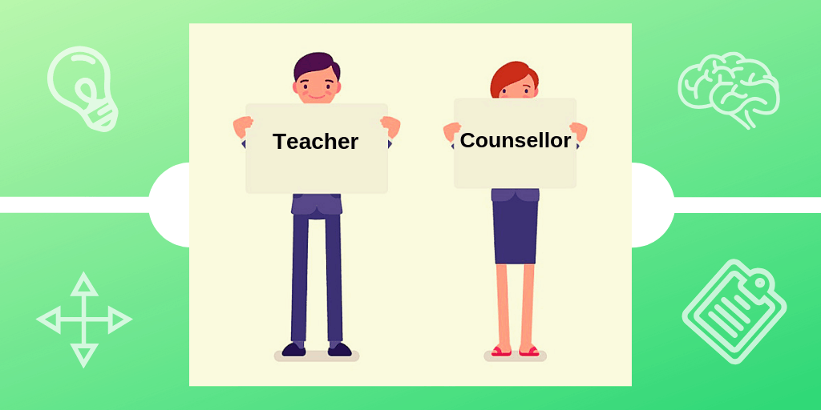
The Greek teachers' training in counselling and how it is currently applied
Eirini Kouki
PhD Candidate at the university of Alicante
Conclusion
I expect
training in counselling to be compulsory in Greek universities
to be provided free annual training seminars for teachers, as knowledge must be enriched
cooperation between teachers and specialized psychologists and school counsellors
Definition of counselling
an talking therapy between a trained therapist and a person or a group of people.
the process of communicating with each other in order to help a person or a group of people who are facing problems and difficulties to manage them on their own.
consultors may be
Psychologists
Psychotherapists
professionals trained in counselling
school counsellors
mental health counsellors
Τhe counselling in schools
Today, in Greece
mainly related to special education,
is limited and has several shortcomings
Even though
brings positive results in school reality such as
a greater sense of safety and success for students
reduction in the extent of children's social and emotional difficulties
counselling support to parents and teachers
cooperation between school and family
Teachers’ role in counselling
should have knowledge and skills in counselling as
develop meaningful relationships with their pupils,
can play a mediating role between pupils and school psychological services
manage difficult behaviors in the classroom
manage their own and children's stress
BIBLIOGRAPHY
Athanasiadou, X. (2011). Counselling psychology in the school context. Hellenic Journal of Psychology, Vol8, pp. 289-308.
Bouchagier, A. (2011). I antilipsi ton ekpaideftikon gia ti simasia tis aftoektimisis ton mathiton kai h simbouleftiki tous paremvasi gia tin enisxisi tis aftoektimisis ton mathiton protobathmias ekpaidefsis. Panepistimio Patron,
Galineas, I. (2006). I simbouleftiki sto dimotiko sxoleio: o daskalos- simvoulos. Ethniko kai kapodistriako panepistimio Athinon,
Kourkoutas, Η., Μakri-Mpotsari Ε., Hart, A., Kassis, W., & Stavrou P. (2019). Counseling Teachers to Enhance Resilience and to Manage Behavioral Problems at School: Data from an Intervention Program. Psychology: The Journal of the Hellenic Psychological Society, 24(1), 9–31. https://doi.org/10.12681/psy_hps.22428
Malakiosi-Loizou, M. (2011).Counselling psychology in today’s Greece. Hellenic Journal of Psychology, Vol8, pp. 266-288.
Poursanidou, E.I. (2016). Problimata siberiforas stin taxi kai paremvasi tou daskalou. Erevna sthn ekpaideusi, 5(1), 62–75. https://doi.org/10.12681/hjre.9380
Roubou, X. (2019, September 21). Adult Education and Counseling Psychology: Investigating Adult Educators' Training Needs ιn Counseling Issues. Elliniko anoikto panepistimio,
Teachers’ training
primary and secondary teachers in Greece are not trained in the basic skills of counselling as the Greek state has not provided for their training before and after completing of their bachelor studies in counselling issues, both on a theoretical and practical level.
therefore teachers on their own initiative should
after the end of the basic studies,
may attend training seminars on counselling practices
continue postgraduate studies in counselling
to be personally informed about how the teacher can effectively help to manage and deal with problems in and out of the classroom

